Slide 1
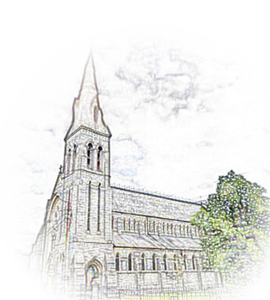

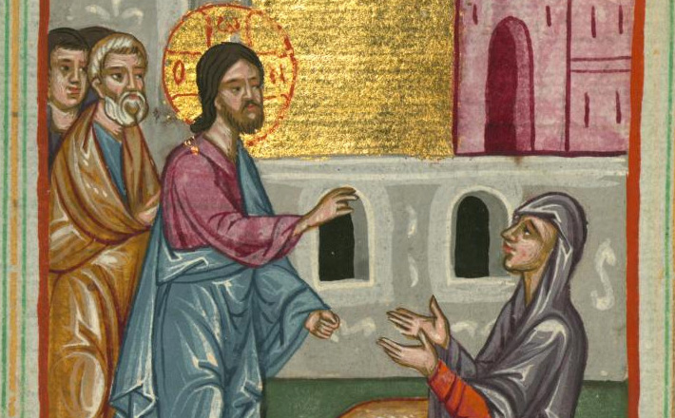


M O N K S T O W N P A R I S H
Parish Secretary
Ann Acres
T: (01) 538 2542
E: secretary@monkstownparish.ie
Parish Administrator
Deacon Eric Cooney
Mobile: 087 668 3499
E: eric.g.cooney@gmail.com
Safeguarding Contacts
Alice O’Connell & Denise Beardmore
E: CP@monkstownparish.ie
Sacristan: Ciarán Ryan
Mass Times: Weekdays (Mon – Fri) @ 10 AM Saturday. Vigil Mass @ 6 PM Sunday. 10:30 AM
P A R I S H N E W S L E T T E R
20th Sunday in Ordinary Time - (15th / 16th August 2026)
MONKSTOWN VILLAGE TIDY DISTRICT HERITAGE WEEK
We remember in our prayer at mass this weekend the following whose anniversaries and month’s mind occur at this time:
Monkstown Castle
Sunday 16th 3 pm – 4pm
Monkstown Castle has a remarkable heritage, and played a prominent role in many events in Irish history. Constructed in the 14th century by the monks of St. Mary’s Abbey to protect their farmland from attack, it was built close to the ancient graveyard where the original medieval monastery is believed to have been located. Archaeology Ireland, supported by DLRCC, has published an attractive Heritage Guide (No. 109) to tell its history.
Séamus Cannon will lead a tour of the castle, tell its history and point out the location of the missing tower and ornamental gardens. The illustrated brochure will be available to all.
https://www.heritageweek.ie/event-listings/monkstown-castle
Online Virtual Tour
monkstown-heritage.com/
With thanks to Dun Laoghaire Rathdown County Council for their support by way of a heritage grant last year, Monkstown Village Tidy District Heritage Sub Committee have been working hard to develop an online map, the first part of this work a virtual walking tour of:
Monkstown Ring
Carrickbrennan Cemetery
Monkstown Castle
Pakenham Road
De Vesci Terrace & The Slopes
Monkstown Crescent
Longford Terrace
Belgrave & Eaton Squares
& Montpellier Parade
Seapoint Martello Tower
Seapoint Bridge
The virtual tour is available on https://monkstown-heritage.com/
We will launch Monkstown Heritage Virtual Walking Tour | National Heritage Week 15th – 23rd August 2026 "Did you notice? A column for the curious stroller" the second part of this project, available on https://www.monkstownvillage.ie/blog, following the Heritage Week talk in CBC Monkstown Park.
Mary Aileen O’Kelly (A)
Marie English Delahunty (A)
Kieran Flynn (A)
Nicholas Treacy (A)
Tommy McAteer (A)
Bob Marah (A)
Murdeach Bradley (A)
Colette O’Shea (RD)
Thomas & Nancy Maher (A)
S V P C o l l e c t I o n
Our local conference of the St. Vincent de Paul will take up their monthly collection next weekend.
Leprosy Mission,
and Juggy’s Well
Wednesday 19th 7 pm to 8:30 pm CBC Monkstown Park
Monkstown Village Tidy District has recently received confirmation from DLR Heritage Office that three additional commemorative plaques will be erected locally. These will celebrate distinguished philanthropist and historian Charles Haliday; the Pim sisters who established the Leprosy Mission, and the historic Juggy’s Well, the primary local source of drinking water for the poor for centuries.
https://www.heritageweek.ie/event-listings/commemorative-plaques-in-monkstown
The encounter between Jesus and the Canaanite woman reveals a faith that refuses to let go. Though she begins at the margins, her perseverance draws her into the heart of God’s compassion. What seems at first like resistance becomes an invitation to deeper trust. Her bold plea shows that faith is often born in struggle, and Christ meets us there. In her persistence, we see how God’s mercy breaks boundaries and opens a place for every seeking heart.
SAVE THE DATE!
Sunday 30th August 2 pm to 6 pm
P A R T N E R S H I P P A R I S H E S MASS TIMES
Kill O’ The Grange
(Holy Family)
Mon – Sat @ 10 am
Sat Vigil 5 pm Sun 10 & 12
Web: www.holyfamilyparish.ie
Blackrock
(St. John the Baptist)
Mon – Fri @ 1:05 pm
Sat Vigil 6:30 pm Sun 10 & 12
Web: www.sjb.ie
Newtownpark
(Guardian Angels)
Mon – Sat @ 10 am
Sun 9:30 10:45
www.newtownparkparish.com
Foxrock
(Our Lady of Perpetual Succor)
Mon, Tue, Thurs & Fri @ 10 am
Sat Vigil 6 pm Sun 10 & 11:30
Web: www.foxrockparish.ie
monkstownparish.ie

